Slide 1
Generosity
How can I be generous to others?

Slide 2
How can I be generous?
You’re at morning tea after church. There is only one jelly cup left. You reach for it at the same time as another kid from church. How can you be generous?
Take the last jelly.
You got there first!
Let the other kid have
the last jelly

Slide 3
Yes!
That would be a generous thing to do!

Slide 4
No
That would NOT be generous!

Slide 5
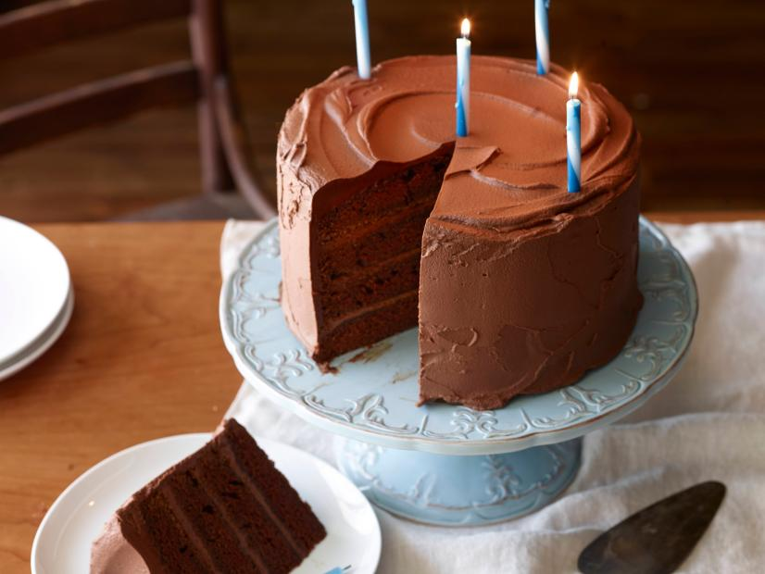
How can I be generous?
It’s your birthday! You get served the biggest slice of chocolate cake. You know your best friend loves chocolate cake too. How can you be generous?
Give the biggest slice to your friend and take their smaller slice.
Eat the biggest slice.
After all, it’s your birthday!

Slide 6
Yes!
That would be a generous thing to do!

Slide 7
No
That would NOT be generous!

Slide 8
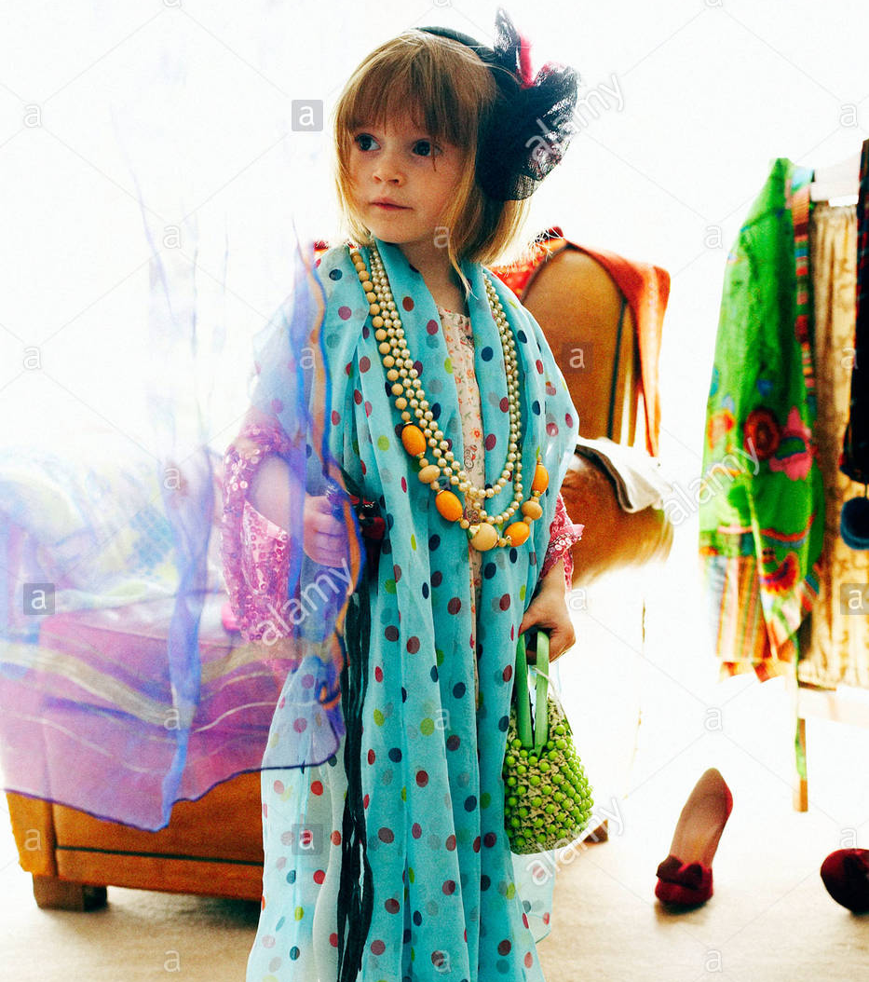
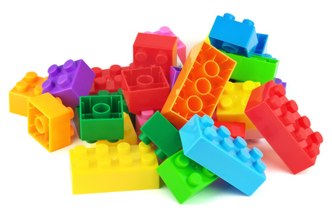
How can I be generous?
You want to play with your new Lego. Your sister wants you to play dress ups with her. How can you be generous with your time?
Tell your sister, sorry, and play with your Lego.
Play dress ups with your sister for a while, and then play with your Lego.

Slide 9
Yes!
That would be a generous thing to do!

Slide 10
No
That would NOT be generous!

Slide 11
How can I be generous?
It’s story time before bed. You want mum to read one book but your brother wants her to read a different book. How can you be generous?
Let your brother choose the book tonight.
Tell your brother it’s YOUR book or NO book!

Slide 12
Yes!
That would be a generous thing to do!

Slide 13
No
That would NOT be generous!

Slide 14
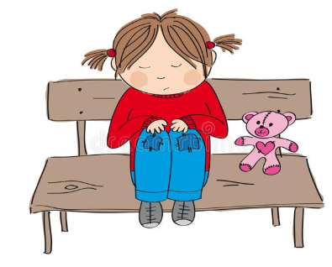
How can I be generous?
It’s recess – your favourite time of the school day! A girl from your class is sitting alone, looking very sad. How can you be generous?
Go and sit with her and try to make her smile.
Run the other way and play with your friends.

Slide 15
Yes!
That would be a generous thing to do!

Slide 16
No
That would NOT be generous!

Slide 17
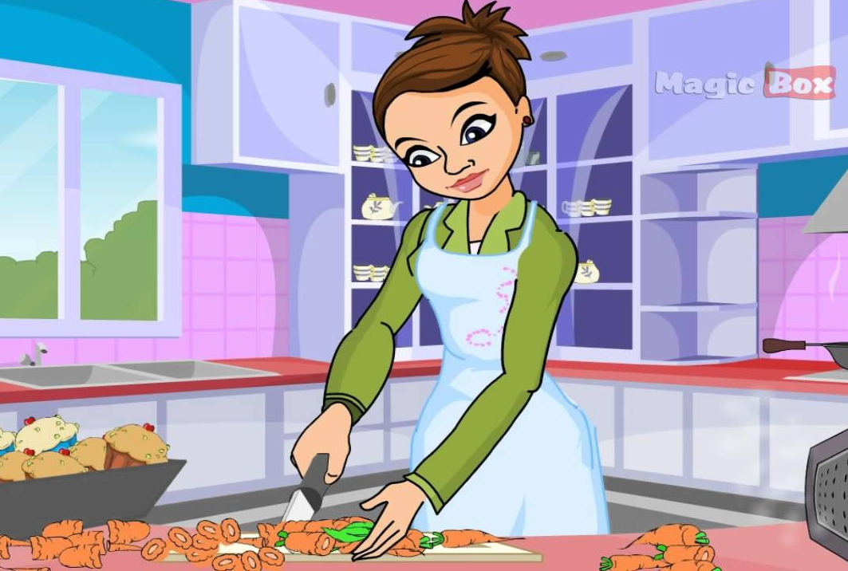
How can I be generous?
Mum just came home from work and looks very tired. She still has to cook dinner for the family. How can you be generous?
Say a quick hello and keep watching TV.
Give her a hug and offer to help her with the cooking.

Slide 18
Yes!
That would be a generous thing to do!

Slide 19
No
That would NOT be generous!

Slide 20
Generosity
What things will you do this week to be generous to others?
Pray that God will help you find ways to show generosity to those around you this week and always, so that you can reflect the love of Jesus to the world!

